Slide 1
H.E.A.T.
IMPLEMENTATION AND FACILITATION
Antonio Conway, Assistant Director of Clinical Services
Moore Counseling & Mediation Services, Inc.

Slide 2
WHAT IS H.E.A.T.?
H-E-A-T stands for Habilitation Empowerment Accountability Therapy.
A culturally sensitive, yet multifaceted treatment approach for African American males ages 18-29
These men most likely have a history criminal behavior and the use, abuse and selling of drugs, poor relationships with self, family, community, and spirituality. Gangs, violence, baby mama drama and involvement with the criminal justice system

Slide 3
HABILITATION OR REHABILITATION?
While “REHABILITATION” refers to regaining skills, abilities or knowledge that may have been lost or compromised as a result of acquiring a disability or due to a change one’s circumstances “HABILITATION” refers to a process aimed at helping people gain certain new skills, abilities and knowledge that they never had to begin with.

Slide 4
WHY H.E.A.T.?
America has approximately 1.8 million people in prison.
Black males represent approximately 45% of state prison inmates convicted of drug offenses despite composing only 12% of the U.S. population although black males do not evidence any higher rates of involvement in substance abuse than other racial groups.

Slide 5
WHY H.E.A.T.?
The life expectancy at birth for black males in the U.S. is lower than that for males in Iran, Columbia and Sri Lanka - populations identified by the United Nations as having “medium human development.”
In fact, the average life expectancy for black males is much closer to that of Viet Nam, El Salvador and Iraq than it is to the life expectancy of white males in the United States.

Slide 6
Selected male life expectancies at birth
United States (white) 74.6
Sri Lanka 71.5
Ecuador 71.4
Malaysia 70.9
Iran 69.0
Columbia 69.3
United States (black) 68.8
Viet Nam 68.6

Slide 7
WHY H.E.A.T.?
According to the Schott report, 47 percent of African-American males graduate from high school. (New York 28 percent, Philadelphia 28 percent, Broward County Florida 39, Washington D.C., Chicago 44 percent, Nashville 47 percent).

Slide 8
Benefits of Education for Black vs. White Men
Black men with a high school diploma only earned 79% of white men
Black men with a college degree only earn 80% of white men
Black men only earned 73% earnings of white men
Black men’s rates of unemployment were 10% higher than white men’s

Slide 9
HOW DOES H.E.A.T. WORK?
The program offers a two-day orientation followed by a 36-week curriculum. There is a facilitator guide along with workbooks for participants.
Each week covers one module across two days.
The curriculum is divided into three parts of twelve weeks each:
12- weeks of developing a relationship with self,
12- weeks of developing a relationship with family,
12- weeks of developing a relationship with your community

Slide 10
Four critical areas that contribute to being a better man
Self
Family
Community
Spirituality

Slide 11
RELATIONSHIP WITH SELF
Knowledge of self
Diet
Health Care
Education
Refraining from self-destructive behaviors

Slide 12
RELATIONSHIP WITH FAMILY
Roles
More than paying child support
Co-parenting
You choose the mother of your children
Father children who are not yours
Take legal action

Slide 13
RELATIONSHIP WITH COMMUNITY
Political
Leadership
Protector
Stand against crime
Clean up the community
Advertisements
Memberships

Slide 14
RELATIONSHIP WITH SPIRITUALITY
A sense of peace
Connection to others
Purpose
Your chosen beliefs about the meaning of life

Slide 15
SPIRITUAL FOUNDATION
Day one of each week addresses the main topic of the module such as “Staying Out of the HEAT”.
Day two session focuses on “Principles to Live By” such as Honesty.
There is a Spiritual Principle on day two for each of the 36 sessions.
This is the glue that makes everything work. There is a prevailing misconception about how real change takes place for our clients.
Most treatment programs operate from a premise that says if you know better you will do better.

Slide 16
SPIRITUALITY: AGENT OF CHANGE
How do people change?
What cause people to think and behave they way they do in the first place when it comes to addiction and criminal behavior?
What do we mean when we say addiction is a disease?
What is the role of genetics, propensities and proclivities?

Slide 17
SPIRITUALITY: AGENT OF CHANGE
Dr. Andrew Newberg- A neuroscientist who wrote the book “How God Changes your Brain”.
“The brain is a stubborn organ. Once its primary set of beliefs has been established, the brain finds it difficult to integrate opposing ideas and beliefs. This has profound consequences for individuals and society and helps to explain why some people cannot abandon destructive beliefs, be they religious, political or psychological.”
― Andrew Newberg

Slide 18
Group Facilitation
The right facilitator is key
Someone who understands group dynamics
Someone who understands the therapeutic process and how to utilize timely interventions
Someone who has the skill of rapport building with this population
Someone who is relatable and has the skill of leadership

Slide 19
Group Dynamics

Slide 20
Group Dynamics
The most influential model of the developmental process, certainly in terms of its impact upon texts aimed at practitioners, has been that of Bruce W. Tuckman (1965).
While there are differences concerning the number of stages and their names, many have adopted a versions of Tuckman’s model:
Forming
Storming
Norming
Performing
Adjourning (Tuckman and Jensen 1977)

Slide 21
Serious issues and feelings are avoided, and people focus on being busy with routines such as: organization, who does what, when to meet, etc.
Individuals are also gathering information and impressions about each other and about the scope of the task and how to approach it.
In the first stages of group building, the individual’s behavior is driven by a desire to be accepted by the others and to avoid controversy or conflict.
Group Dynamics: Forming

Slide 22
The forming stage of any team is important because in this stage, the members of the team get to know one another.
This is a comfortable stage to be in, but the avoidance of conflict and threat means that not much actually gets done.
Supervisors of the team tend to need to be directive during this phase.
Group Dynamics: Forming

Slide 23
Group Dynamics: Storming
The storming stage is necessary to the growth of the team. It can be contentious, unpleasant and even painful to members of the team who are averse to conflict.
Tolerance of each team member and their differences should be emphasized. Without tolerance and patience, the team will fail.
This phase can become destructive to the team and will lower motivation if allowed to get out of control.

Slide 24
Group Dynamics: Storming
Every group will next enter the storming stage in which different ideas compete for consideration.
Members open up to each other and confront each other’s ideas and perspectives.
In some cases, storming can be resoled quickly.
The maturity of some members usually determines whether the team will ever move out of this state. Some team members will focus on minutiae to evade real issues.

Slide 25
Group Dynamics: Norming
The group manages to have one goal and come to a mutual plan.
In this stage, all members take the responsibility and have the ambition to work for the success of the team’s goal.

Slide 26
Group Dynamics: Performing
It is possible for some groups to reach the performing stage. By this time, they are motivated and knowledgeable.
Dissent is expected and allowed as long as it is channeled through means acceptable to the team.
For example, a change in leadership may cause the team to revert to storming as the new people challenge the existing norms and dynamics of the team.

Slide 27
Components of
Group Success

Slide 28
Components of Group Success
Understanding mechanisms of action in group psychotherapy.
Seasoned group therapists recognize that the success of individual group members is intimately linked to the overall health of the group as a whole.

Slide 29
Primary Factors
According Yalom, there are 11 factors that are a part of group counseling.
We will cover each one.

Slide 30
Therapeutic Factors
Instillation of hope
Universality
Imparting information
Existential factors
Development of socializing techniques
Imitative behavior
Interpersonal meaning
Group Cohesiveness
Catharsis
Corrective recapitulation of primary family group.

Slide 31
How Groups are Constructed
Therapy groups may be homogeneous or heterogeneous.
Homogeneous groups have members with similar diagnostic backgrounds (for example, they may all suffer from depression).
Heterogeneous groups contain a mixture of individuals with different emotional problems. The number of group members typically ranges from five to twelve.

Slide 32
Group Structure

Slide 33
Group Structure
The leader modeling real-time observations, guiding effective interpersonal feedback, and maintaining a moderate level of control and affiliation may positively impact cohesion.
The timing and delivery of feedback should be pivotal considerations for leaders as they facilitate the relationship-building process.
Must consider the stage of the group.
Why is this important?
What happens if you challenge someone to early in the process.

Slide 34
Group Structure
Establishing & Maintaining an
Emotional Climate
The group leader’s presence affects:
Individual members
The group as a whole
Why
They vicariously experience leader’s manner of relating.
The leader’s management of emotional presence in the service of others is critically important.

Slide 35
Group Structure
A primary focus of the group leader should be on facilitating the group members’ emotional expression.
The responsiveness of others to that expression.
The shared meaning derived from such expression.

Slide 36
Group Leadership

Slide 37
Types of Leaders - Autocratic
Authoritarian leaders, also known as autocratic leaders:
Provide clear expectations for what needs to be done, when it should be done, and how it should be done.
There is also a clear division between the leader and the followers.
Authoritarian leaders make decisions independently with little or no input from the rest of the group.

Slide 38
Types of Leaders - Autocratic
Negatives:
Researchers found that decision-making was less creative under autocratic leadership.
Abuse of this style is usually viewed as controlling, bossy and dictatorial.
Authoritarian leadership is best applied to situations where there is little time for group.

Slide 39
Types of Leaders – Democratic
Participative or Democratic Leadership is generally the most effective leadership style.
Democratic leaders offer guidance to group members, but they also participate in the group and allow input from other group members.

Slide 40
Types of Leaders – Democratic
Participative leaders encourage group members to participate but retain the final say over the decision-making process.
Group members fell engaged in the process and are more motivated and creative.

Slide 41
H.E.A.T. Groups
Language
Frequent deviations from the main task
Initial high level of Ambivalence
Cell phone distraction
Staff splitting
Glamorization/defense of drug selling as a means of survival

Slide 42
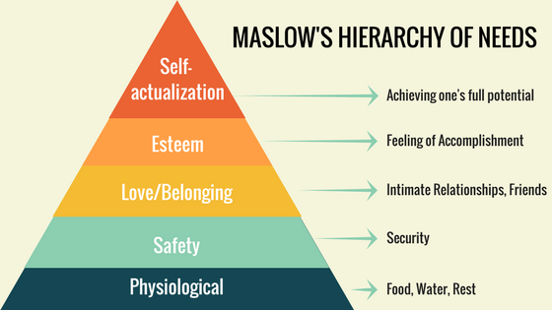

Slide 43
Program Structure
Mondays and Tuesdays
Mornings or Evenings
5 pm-6:30pm or 10:30am-12pm
Combine with I.O.P if necessary(1.5hr IOP/1.5hr H.E.A.T)
After completion of I.O.P client’s attend H.E.A.T sessions
Weekly Individual counseling sessions by Clinical Case Manager
Constant contact through via cell phones

Slide 44
Challenges
Conducting H.E.A.T. Orientation for new clients
Community portion of H.E.A.T. is a closed group
Transportation
Navigating the Healing Voices project
Involving community partners
Completion of the program spelled out at the Drug court Orientation

Slide 45
COMMUNITY PROJECT: HEALING VOICES
“Healing Voices is a photo/voice method commonly used in the field of community development, public health, and education that combines photography with grass roots social action”.
Clients take photos that represent the point of view of their community and develop a narrative that goes along with the photo as well as discuss their strategy for appropriate action.

Slide 46
COMMUNITY PROJECT: HEALING VOICES
The client has learned about institutional barriers to equity including socio-economic policies that impact neighborhood conditions and how to explore the root causes of such conditions related to these same policies.
The project stretches over the course of six weeks and culminates into a viewing and presentation in the company of family, friends, community leaders, policy makers and other stakeholders that have been personally invited to hear the client’s experiences and ideas.

Slide 47
Tips For Healing Voices
Use the phone
Clothing
Communicate the project appropriately
Projects in picture form
May need to work in a group throughout
Invitation of family members and Community Leaders
Food served
Program
Pictures

Slide 48
Photos

Slide 50
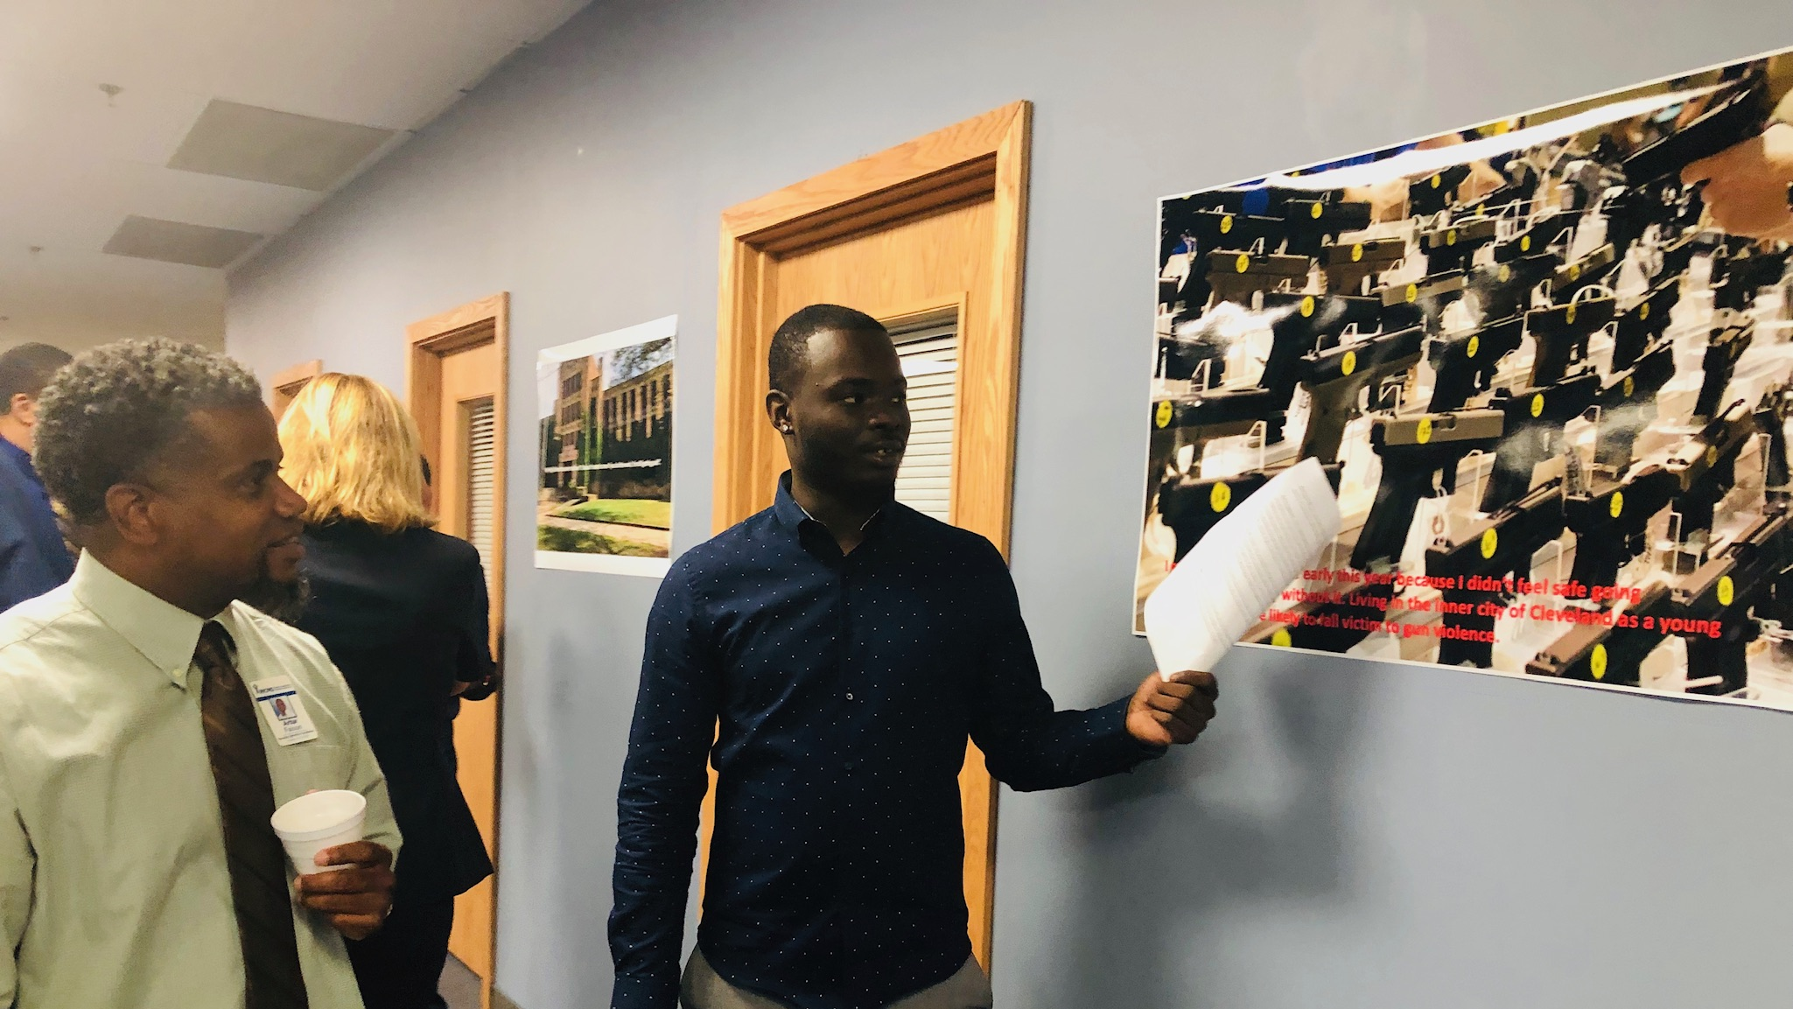

Slide 51
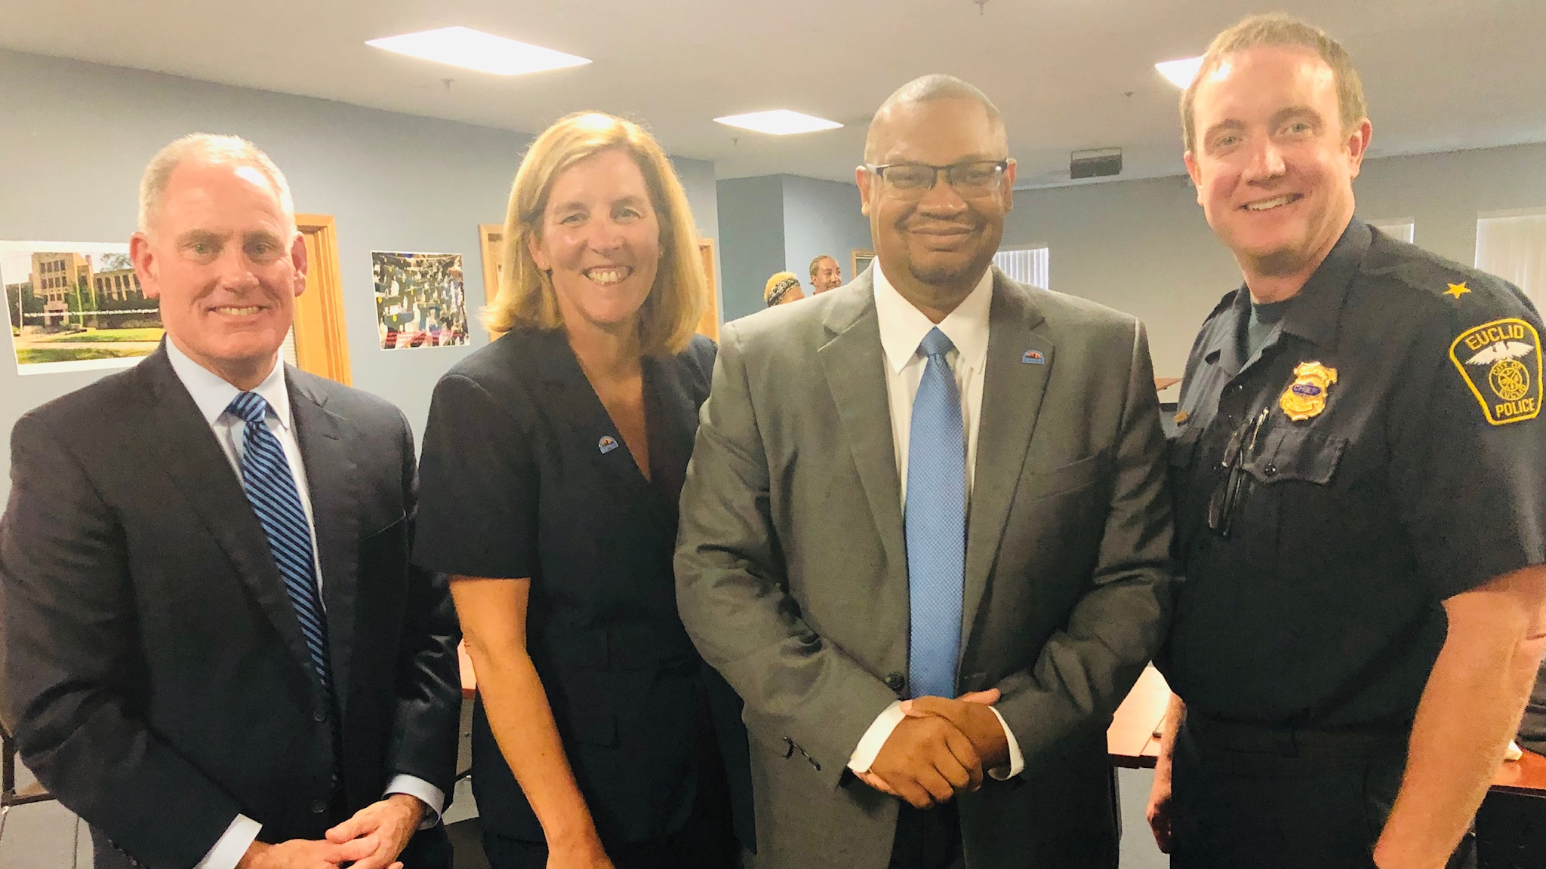

Slide 53
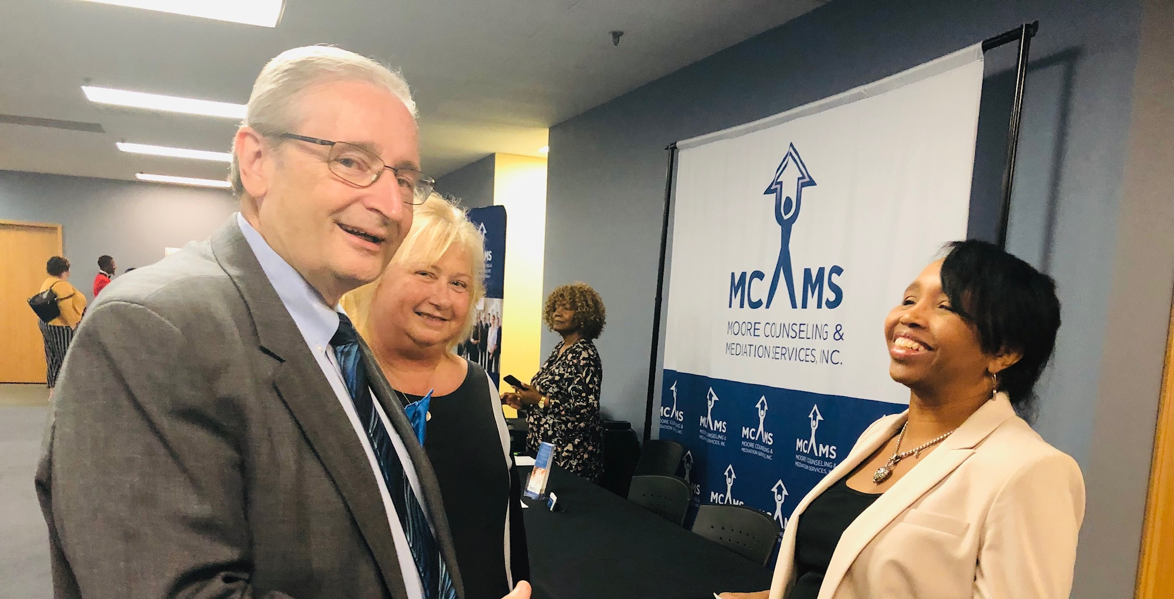

Slide 54
HOW TO START H.E.A.T. IN YOUR AREA
Contact Information:
Heattime.com, or
Heattime.org
Co-founder-Darryl Turpin, Darrylturpin@yahoo.com, or at 502-558-1224
Co-founder-Guy Wheeler, 954-261-6222

Slide 55
H.E.A.T.
For additional information regarding the implementation of the H.E.A.T program with addiction treatment, please contact Antonio Conway at 216-404-1900 or by email at aconway@moorecounseling.com.

